Slide 1

Chapter 9 - Scheduling
I want a turn. Now!

Slide 2
CS 345
Stalling’s Chapter | # | Project
1: Computer System Overview 2: Operating System Overview | 4 | P1: Shell
3: Process Description and Control 4: Threads | 4 | P2: Tasking
5: Concurrency: ME and Synchronization 6: Concurrency: Deadlock and Starvation | 6 | P3: Jurassic Park
7: Memory Management 8: Virtual memory | 6 | P4: Virtual Memory
9: Uniprocessor Scheduling 10: Multiprocessor and Real-Time Scheduling | 6 | P5: Scheduling
11: I/O Management and Disk Scheduling 12: File Management | 8 | P6: FAT
Student Presentations | 6

Slide 3
Chapter 9 Learning Objectives
After studying this chapter, you should be able to:
Explain the differences among long, medium, and short-term scheduling.
Assess the performance of different scheduling policies.
Understand the scheduling techniques used by contemporary operating systems.

Slide 4
CPU Scheduling
Scheduling
What is scheduling?
Fundamentally, scheduling is a matter of managing queues to minimize queuing delay and to optimize performance in a queuing environment.
Scheduling is central to OS design
Process
Ready
Execution
Begins
Process
Responds
Process
Finishes
Wait Time
Response Time
Execution Time
Turnaround Time

Slide 5
Scheduling Criteria
Scheduling
Criteria | Maximize | Minimize
CPU utilization – keep the CPU as busy as possible.
✓
Throughput – # of processes that complete their execution per time unit.
✓
Turnaround time – time to execute a process from submission to completion.
✓
Waiting time – amount of time a process has been waiting in the ready queue.
✓
Response time – time it takes from when a request was submitted until the first response is produced, not output (for time-sharing environment).
✓

Slide 6
Switching is Expensive
Scheduling
Process A
Process A
Switch to Kernel
Kernel
Switch to User
Pick a process
Process B
Process B
Reset MMU
Store Process State
Load Process State
Memory

Slide 7
Overhead
Scheduling
What does scheduling cost?
Direct Cost: time to actually switch
Indirect Cost: performance hit from memory (dirty cache, swapped out pages, etc.)
How would you describe program execution?
CPU burst distribution is of main concern.
Compute Bound
Computation intensive.
I/O Bound
Short bursts of execution, long waits for I/O.
160
140
120
100
80
60
40
20
Most processes have a
large number of short
CPU bursts
Frequency
0 8 16
Burst Duration (milliseconds)
Compute-bound:
I/O-bound:

Slide 8
When to Schedule?
Scheduling
When is scheduling needed?
Process creation
Process exit
Process blocks
Higher priority process becomes ready
I/O Interrupt (resource becomes available)
What are the two types of schedulers?
Non-preemptive
Execute until yield, exit, or block.
Preemptive
Highest priority process ALWAYS executing
Reschedule immediately on events (interrupt if necessary).

Slide 9
Queuing Diagram for Scheduling
Scheduling
Long-term
-performed when new process is created
-the more processes created, the smaller
the percentage of time for each process
-keep a mix of processor-bound and I/O-bound
Time-out
Batch
jobs
Ready Queue
Release
Processor
Short-term
-which ready process to execute next
-clock interrupts, I/O interrupts,
system calls, signals
Ready, Suspend Queue
Medium-term
-swapping to maintain a degree of
multiprogramming
-memory management an issue
(virtual memory)
Blocked, Suspend Queue
Blocked Queue
Event Wait
Event
Occurs
Notes:
9

Slide 10
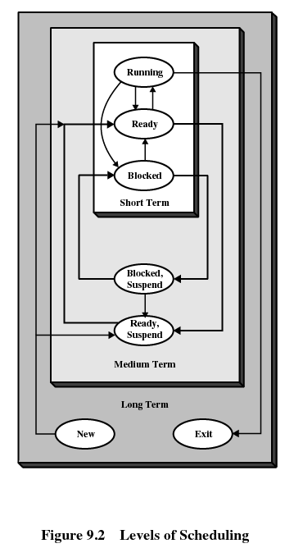
Scheduling Goals
Scheduling
All Systems
Fairness
Policy Enforcement
Balance
Batch Systems
Throughput
Turnaround time
CPU utilization
Interactive Systems
Response time
Proportionality
User experience
Real-time Systems
Meeting deadlines
Predictability
Stability
Notes:
Policy enforcement: consider a nuclear power plant, the policy says safety control runs anytime it wants. Then the schedule enforces this policy even though it means payroll may be late.
10

Slide 11
Scheduling Criteria
Scheduling Criteria
Throughput : Number of jobs processed per unit of time.
Turnaround time: Time from submission to completion.
Response time: Time to start responding (interactive users).
Deadlines: Maximize number of deadlines met (real-time).
Processor utilization: Percent of time CPU is busy.
Proportionality: Things meet expectations.
Predictability: Same time/cost regardless of system load.
Fairness: No process should suffer starvation.
Enforcing priorities: Favor higher priority processes.
Balancing resources: Keep system resources busy.

Slide 12
Preemptive vs. Non-preemptive
Preemption
Scheduling that only takes place due to I/O or process termination is non-preemptive.
Preemptive scheduling allows the operating system to interrupt the currently running process and move it to the ready state.
new process arrives
clock interrupt
Preemptive scheduling:
incurs greater overhead (context switch)
provides better service to the total population of processes
may prevent one process from monopolizing the processor

Slide 13
Response Time
Response Time
User productivity tends to improve with a more rapid response time.
Especially true for expert users
Becomes very noticeable as response time drops below 1 second
User time or “think time” – Time user spends thinking about the response.
System time – Time system takes to generate its response.
Short response times are important
User response time tends to decrease as system response time decreases
If the system gets too slow to a user, they may slow down or abort the operation
Turnaround time (TAT) – total time that an item spends in the system.

Slide 14
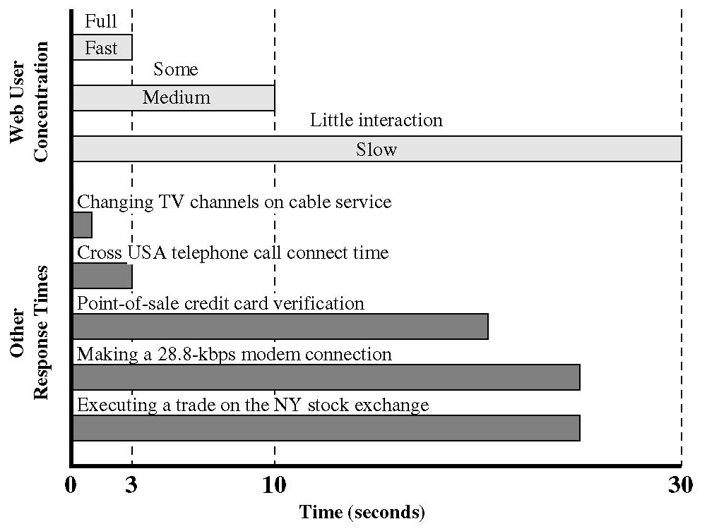
Response Time (continued…)
Response Time
Web Pages – Loading a page in 3 seconds or less increases the user’s attention
User may abort after 10s or more
Must balance response time with the cost required
Faster/more expensive hardware may be required
Priorities that may penalize certain processes

Slide 15
Response Times (continued…)
Response Time
15 seconds or greater
•Rules out conversational interaction.
•Most users will not wait this long.
•If it cannot be avoided, allow the user to continue on to something else (like foreground/background threads).
4 to 15 seconds
•Generally user loses track of the current operation in short-term memory
•Ok after end of a major closure
2 to 4 seconds
•Inhibits user concentration
•Bothers a user who is focused on the job
•Ok after end of a minor closure
1 to 2 seconds
•Important when information has to be remembered over several responses
•Important limit for terminal activities
Less than 1 second
•For keeping user’s attention for thought-intensive activities
•Example: graphics
Less than 1/10 second
•Response to key presses or mouse clicks

Slide 16
Scheduling
Scheduling
Priorities
Are some processes more important than others?
Don’t want to starve low-priority processes
Decision Mode
Will we suspend the currently active process if it can continue?
No: Nonpreemptive
Yes: Preemptive
Some systems (Win 3.1, early Mac) used cooperative multitasking (processes voluntarily give up the CPU)
Preemption incurs more O.S. overhead, but prevents monopolizing the processor
Also helps with infinite loops

Slide 17
Scheduling Algorithms
Algorithms
First Come First Served (FCFS)
Round Robin (RR) – time slicing.
Shortest Process Next (SPN)
Shortest Remaining Time (SRT)
Highest Response Ratio Next (HRRN)
Feedback

Slide 18
First-Come-First-Served (FCFS)
Algorithms
Simplest scheduling algorithm - process joins the Ready queue upon arrival, oldest process in the Ready queue is selected (non-preemptive).
A short process may have to wait a very long time before it can execute, thus favors CPU-bound processes over I/O-bound processes - I/O processes have to wait until CPU-bound process completes.
FCFS, although not attractive alternative for a uni-processor system, when combined with a priority scheme may prove to be an effective scheduler.
Process | Arrival | Service
1 | 0 | 3
2 | 2 | 6
3 | 4 | 4
4 | 6 | 5
5 | 8 | 2
1
2
3
4
5
0 | 1 | 2 | 3 | 4 | 5 | 6 | 7 | 8 | 9 | 10 | 11 | 12 | 13 | 14 | 15 | 16 | 17 | 18 | 19 | 20
1
2
3
4
5

Slide 19
Round Robin (RR)
Algorithms
Uses FCFS w/preemption - based on a time quantum coming from a clock (time slicing).
Short time quantum: processes move relatively quickly through the system (with more overhead).
The time quantum should be slightly greater than the time required for a typical interaction.
Particularly effective in GP time-sharing or transaction processing system.
Generally favors processor bound processes as I/O bound give up their time slice while process bound use their complete time quantum.
Process | Arrival | Service
1 | 0 | 3
2 | 2 | 6
3 | 4 | 4
4 | 6 | 5
5 | 8 | 2
1
2
3
4
5
0 | 1 | 2 | 3 | 4 | 5 | 6 | 7 | 8 | 9 | 10 | 11 | 12 | 13 | 14 | 15 | 16 | 17 | 18 | 19 | 20
1
Could be improved using a virtual round robin (VRR) scheduling scheme – implement an auxiliary I/O queue which gets preference over the main queue.
2
3
4
5

Slide 20
Shortest Process Next (SPN)
Algorithms
Non-preemptive policy - Process with shortest expected processing time is selected next.
Short process jumps ahead of longer processes.
May be impossible to know or at least estimate the required processing time of a process.
Batch jobs require a programmer’s estimate. (If estimate is substantially off, system may abort job.)
In a production environment, the same jobs run frequently and statistics may be gathered.
In an interactive environment, the operating system may keep a running average of each “burst” for each process.
SPN could result in starvation of longer processes if there is a steady supply of short processes.
Not suitable for time-sharing or transaction processing environment because of lack of preemption.
Process | Arrival | Service
1 | 0 | 3
2 | 2 | 6
3 | 4 | 4
4 | 6 | 5
5 | 8 | 2
1
2
3
4
5
0 | 1 | 2 | 3 | 4 | 5 | 6 | 7 | 8 | 9 | 10 | 11 | 12 | 13 | 14 | 15 | 16 | 17 | 18 | 19 | 20
1
2
3
4
5

Slide 21
Shortest Remaining Time (SRT)
Algorithms
The shortest remaining time (SRT) policy is a preemptive version of SPN.
Must estimate expected remaining processing time
When a new process joins the ready queue, it may have a shorter remaining time and preempts the current process.
SRT does not bias in favor of long processes (as does FCFS)
Unlike RR, no additional interrupts are generated reducing overhead.
Superior turnaround performance to SPN, because a short job is given immediate preference to a running longer job.
Process | Arrival | Service
1 | 0 | 3
2 | 2 | 6
3 | 4 | 4
4 | 6 | 5
5 | 8 | 2
1
2
3
4
5
0 | 1 | 2 | 3 | 4 | 5 | 6 | 7 | 8 | 9 | 10 | 11 | 12 | 13 | 14 | 15 | 16 | 17 | 18 | 19 | 20
1
2
3
4
5

Slide 22
Highest Response Ratio Next (HRRN)
Algorithms
Process | Arrival | Service
1 | 0 | 3
2 | 2 | 6
3 | 4 | 4
4 | 6 | 5
5 | 8 | 2
Non-preemptive, similar to Shortest Job Next (SJN) but without starvation.
Attractive approach to scheduling because it accounts for the age of a process.
While shorter jobs are favored (a smaller denominator yields a larger ratio), aging without service increases the ratio so that a longer process will eventually get past competing shorter jobs.
time spent waiting + expected service time
expected service time
HRRN₄ = (7 + 5) / 5 = 2.4
HRRN₅ = (5 + 2) / 2 = 3.5
1
2
3
4
5
0 | 1 | 2 | 3 | 4 | 5 | 6 | 7 | 8 | 9 | 10 | 11 | 12 | 13 | 14 | 15 | 16 | 17 | 18 | 19 | 20
1
2
3
HRRN₃ = (5 + 4) / 4 = 2.25
HRRN₄ = (3 + 5) / 5 = 1.6
HRRN₅ = (1 + 2) / 2 = 1.5
4
5

Slide 23
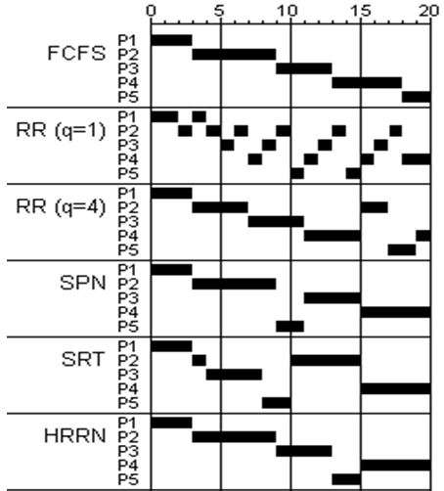
Comparisons
Comparisons
P1
P2
P3
P4
P5
Mean
P1: arrives at time 0, requires 3 units
P2: arrives at time 2, requires 6 units
P3: arrives at time 4, requires 4 units
P4: arrives at time 6, requires 5 units
P5: arrives at time 8, requires 2 units
Arrival
0
2
4
6
8
Service Time
3
6
4
5
2
FCFS
Finish
3
9
13
18
20
Turnaround
3
7
9
12
12
8.60
Tr / Ts
1.00
1.17
2.25
2.40
6.00
2.56
RR (q=1)
Finish
4
18
17
20
15
Turnaround
4
16
13
14
7
10.80
Tr / Ts
1.33
2.67
3.25
2.80
3.50
2.71
RR (q=4)
Finish
3
17
11
20
19
Turnaround
3
15
7
14
11
10.00
Tr / Ts
1.00
2.50
1.75
2.80
5.50
2.71
SPN
Finish
3
9
15
20
11
Turnaround
3
7
11
14
3
7.60
Tr / Ts
1.00
1.17
2.75
2.80
1.50
1.84
SRT
Finish
3
15
8
20
10
Turnaround
3
13
4
14
2
7.20
Tr / Ts
1.00
2.17
1.00
2.80
1.00
1.59
HRRN
Finish
3
9
13
20
15
Turnaround
3
7
9
14
7
8.00
Tr / Ts
1.00
1.17
2.25
2.80
3.50
2.14

Slide 24
Scheduling Exercise
Process | Arrival | Service
1 | 0 | 5
2 | 2 | 9
3 | 3 | 4
4 | 6 | 7
 | 0 |  |  |  |  | 5 |  |  |  |  | 10 |  |  |  |  | 15 |  |  |  |  | 20
FCFS
RR
SPN
SRT
HRRN

Slide 25
Scheduling Exercise
Process | Arrival | Service
1 | 0 | 5
2 | 2 | 9
3 | 3 | 4
4 | 6 | 7
1
2
3
4
 | 0 |  |  |  |  | 5 |  |  |  |  | 10 |  |  |  |  | 15 |  |  |  |  | 20
FCFS
RR
SPN
SRT
HRRN
1 | 1 | 1 | 1 | 1
2 | 2 | 2 | 2 | 2 | 2 | 2 | 2 | 2
3 | 3 | 3 | 3
4 | 4 | 4 | 4 | 4 | 4 | 4
1 | 1 | 2 | 3 | 1 | 2 | 3 | 4 | 1 | 2 | 3 | 4 | 1 | 2 | 3 | 4 | 2 | 4 | 2 | 4 | 2 | 4 | 2 | 4 | 2
1 | 1 | 1 | 3 | 3 | 3 | 3 | 1 | 1 | 4 | 4 | 4 | 4 | 4 | 4 | 4 | 2 | 2 | 2 | 2 | 2 | 2 | 2 | 2 | 2
1: (3+5)/5 = 1.6
2: (0+9)/9 = 1
3: (3+4)/4 = 1.75
4: (0+7)/7 = 1
1: (0+5)/5 = 1
2: (1+9)/9 = 1.1
3: (0+4)/4 = 1
1: (7+5)/5 = 2.4
2: (4+9)/9 = 1.4
4: (4+7)/7 = 1.6
1: (0+5)/5 = 1
2: (0+9)/9 = 1
2: (6+9)/9 = 1.7
4: (6+7)/7 = 1.9
1 | 1 | 1 | 1 | 1 | 3 | 3 | 3 | 3 | 4 | 4 | 4 | 4 | 4 | 4 | 4 | 2 | 2 | 2 | 2 | 2 | 2 | 2 | 2 | 2
1 | 1 | 1 | 2 | 2 | 2 | 3 | 3 | 3 | 3 | 1 | 1 | 4 | 4 | 4 | 4 | 4 | 4 | 4 | 2 | 2 | 2 | 2 | 2 | 2

Slide 26
Other Scheduling Methods
Feedback Scheduling
Multi-level Feedback Queue
Guaranteed Scheduling
Lottery Scheduling
Fair Scheduling
Completely Fair Scheduler (CFS)
Fair-share scheduling

Slide 27
Feedback Scheduling
Algorithms
If we have no indication of the relative length of various processes, then SPN, SRT, and HRRN cannot be effectively used.
Goals of Multi-Level Feedback Queuing:
Optimize turnaround time - focus is not on time remaining, but on time spent in execution so far.
Be responsive to interactive users.
MLFQ varies the priority of a job based on its observed behavior.
Give preference to shorter jobs by penalizing jobs that have been running longer.
Give preference to I/O bound processes.
Separate processes into categories based on their processor needs.
Feedback scheduling is done on a preemptive basis with a dynamic priority mechanism.

Slide 28
Multi-level Feedback Queue
Algorithms
Possible MLFQ scheduling algorithm:
New jobs are placed at the highest priority (top) queue.
If a job uses up an entire time slice while running, its priority is reduced (i.e., it moves down one queue).
If a job gives up the CPU before the time slice is up, it stays at the same priority level.
Within each queue, a simple FCFS mechanism is used except once in the lowest-priority queue, which is treated in a RR fashion.
After some time period S, move all the jobs in the system to the topmost queue.
Results
As longer processes drift downward, shorter processes are favored.
Can make turnaround time for longer processes intolerable.
To avoid starvation, preemption time for lower-priority processes is usually longer.
A process is demoted to the next lower-priority queue each time it returns to the ready queue.

Slide 29
Feedback Algorithm
Algorithms
A new process is inserted at the end of the top-level FIFO queue.
At some stage the process reaches the head of the queue and is assigned the CPU.
If the process is completed within the time quantum of the given queue, it leaves the system.
If the process voluntarily relinquishes control of the CPU, it leaves the queuing network, and when the process becomes ready again it is inserted at the tail of the same queue which it relinquished earlier.
If the process uses all the quantum time, it is pre-empted and inserted at the end of the next lower level queue. This next lower level queue will have a time quantum which is more than that of the previous higher level queue.
This scheme will continue until the process completes or it reaches the base level queue.
At the base level queue the processes circulate in round robin fashion until they complete and leave the system. Processes in the base level queue can also be scheduled on a first come first served basis.[4]
Optionally, if a process blocks for I/O, it is 'promoted' one level, and placed at the end of the next-higher queue. This allows I/O bound processes to be favored by the scheduler and allows processes to 'escape' the base level queue.

Slide 30
Guaranteed Scheduling
Guaranteed Scheduling
If n ready processes, then each process is entitled to 1/n of CPU time.
Track creation time (T_{c})
Track CPU time actually used (T_{u})
CPU entitled time = (time since creation) / n (T_{e})
Priority = (CPU time used ) / (CPU entitled time ) (T_{u} / T_{e})
Schedule process with smallest ratio (and run to completion).
0.5 → only half of process’ entitled time
2.0 → Twice more than entitled
Notes:
30

Slide 31
Guaranteed Scheduling
Guaranteed Scheduling
Track creation time (T_{c})
Track CPU time actually used (T_{u})
CPU entitled time = (time since creation) / n (T_{e})
Priority = T_{u} / T_{e}
Current time is 13
P₀
P₂
P₃
P₄
T_{c} = 0
T_{u} = 4
T_{c} = 2
T_{u} = 1
T_{c} = 2
T_{u} = 2
T_{c} = 4
T_{u} = 6
T_{e} = 13 / 4
= 3.25
T_{e} = 11 / 4
= 2.75
T_{e} = 11 / 4
= 2.75
T_{e} = 9 / 4
= 2.25
P = 4 / 3.25
= 1.23
P = 1 / 2.75
= 0.36
P = 2 / 2.75
= 0.72
T_{e} = 6 / 2.25
= 2.66
Notes:
Tc is the time of creation
Tu is the time used on CPU thus far
Te is the time it is entitled too use (determined when scheduled based on priority and past behavior—finishing before or after time slice) computed by dividing the time the process has been active by the total number of processes
P is the priority: ratio of time consumed over entitled time
Highest priority wins
31

Slide 32
Lottery Scheduling
Lottery Scheduling
Issue tickets to processes at beginning of each scheduling cycle.
Choose random ticket as next job - if you have the ticket, then its you
Assign number of tickets by priority
With 100 tickets, if a process has 20 tickets, then the process has a 20% chance it wins the lottery
Order within scheduling cycle doesn’t matter
Can exchange tickets
Can award tickets to priority boost

Slide 33
Lottery Scheduling
Lottery Scheduling
Issue 100 Lottery Tickets
P₀
30%
P₂
15%
P₃
25%
P₄
30%
T = 30
T = 15
T = 25
T = 30
Ticket holder gets CPU until next drawing
Notes:
Showing priorities with each process.
Allocated tickets according to priority
33

Slide 34
Fair Scheduling
Fair Scheduling
User’s application runs as a collection of processes (threads)
Unfair to make scheduling decisions solely based on individual processes/threads
More fair to allocate time according to groups
First allocate time fairly to group
then divide the time between processes owned by the group
Repeat recursively
User 1: ABCD, User 2: E. To be fair, each gets ½
Standard RR: ABCDEABCDE…
Each user has fair share: AEBECEDE…
But if user 1 entitled to twice as much…
Fair Scheduling: ABECDEABECDE…
Notes:
34

Slide 35
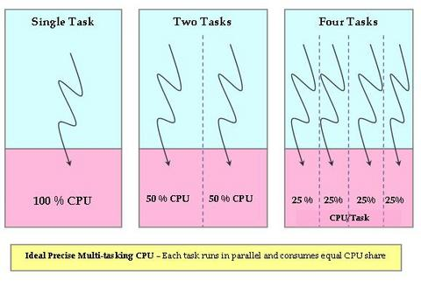
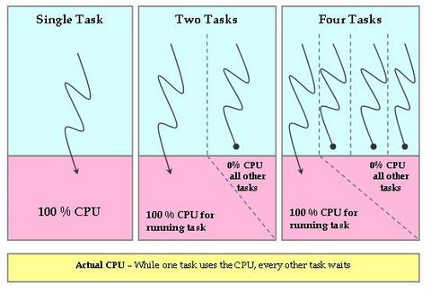
Completely Fair Scheduler (CFS)
CPU virtualization is achieved by “sharing” the CPU between multiple tasks—that is, each running task gets a small fraction of the CPU at regular intervals.
O(1) Scheduler
Uses active and expired arrays.
Complex heuristics to determine interactive vs non-interactive processes (average sleep time, priority boost,…)
CFS Scheduler
Based on parallel CPU power allotment to eliminate “unfairness”.
Scheduler tracks the amount of time it would have used on the ideal processor and is used to rank processes for scheduling and to determine the amount of time the process is allowed to execute before being preempted.
The process with the longest wait time (that is, with the gravest need of CPU) is picked by the scheduler and assigned to the CPU.

Slide 36
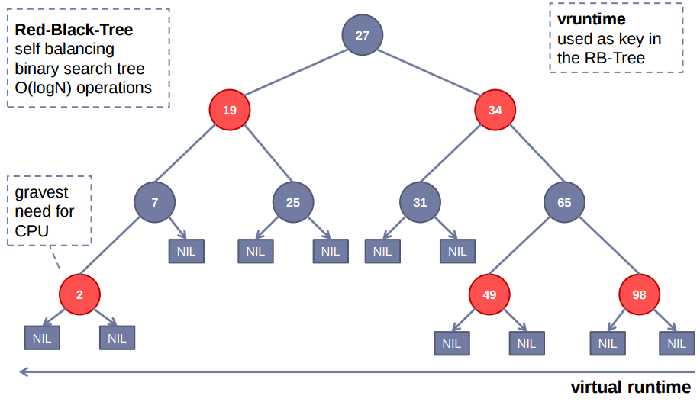
Linux 2.6.21 Completely Fair Scheduler (CFS)
Fair Scheduling
Notes:
http://www.ibm.com/developerworks/linux/library/l-completely-fair-scheduler/
Con Kolivas was pitching a rotating staircase deadline scheduler (RSDL) that incorporated fairness with a bound—goal is maximize CPU usage while retaining interactive responsiveness. Ingo Molnar who wrote the O(1) took ideas from Con Kolivas and put together in 62 hours of program a 100k line patch that is the CFS scheduler (came with no small amount of controversy too as Con’s scheduler was discussed as being mainlined in 2.6.21 when Ingo released the CFS which was quickly adopted and mainlined over RSDL).
The goal is to balance fairness in providing processor time to tasks. A process should be given a fair amount of process time. The CFS maintains the amount of time provided to a given task in what is called the virtual runtime. The smaller a task’s virtual runtime—the smaller amount of time a task has been permitted on the processor—the higher its need for the processor. The CFS also includes the concept of sleeper fairness to ensure that tasks that are not currently runnable (waiting for I/O) receive a comparable share of the processor when they eventually need it.
Tasks are not in a run queue anymore. They are in a red-black tree (balance binary tree). The tree is queue on virtual runtime. The task with the least virtual runtime (gravest need) is in the left most branch. The task with the least need is in the right most branch. The scheduler, to be fair, picks the left most node of the tree to schedule next. The task accounts for its time with the CPU by adding its execution time to the virtual runtime and is then inserted back into the tree if runnable. In this way, tasks on the left side of the tree are given time to execute, and the contents of the tree migrate from the right to the left to maintain fairness.
The pre-emption is set dynamically depending on the task priority. Priorities still dynamically adjust. And the rates of virtual runtime are scaled according to priority as well (i.e., time passes at different rates for each task to account for priority in the “fairness”).
CFS in 2.6.24 includes the ability to group schedule.
Other improvements include the modularity of the scheduler.
36

Slide 37
Lab 5 – Fair-Share Scheduler

Slide 38
Project 5 – FSS
Scheduling is the method by which threads or processes are given access to system resources (e.g. processor time).
Scheduling is usually concerned with load balancing a system effectively to achieve a target quality of service.
Fair-share scheduling (FSS) is a scheduling strategy for computer operating systems in which the CPU usage is equally distributed among system users or groups, as opposed to equal distribution among processes.

Slide 39
Fair Scheduling
Fair-share scheduling is a scheduling strategy for computer operating systems in which the CPU usage is equally distributed among system users or groups, as opposed to equal distribution among processes.
For example, if four users (A,B,C,D) are concurrently executing one process each, the scheduler will logically divide the available CPU cycles such that each user gets 25% of the whole (100% / 4 = 25%).
If user B starts a second process, each user will still receive 25% of the total cycles, but each of user B's processes will now use 12.5%. On the other hand, if a new user starts a process on the system, the scheduler will reapportion the available CPU cycles such that each user gets 20% of the whole (100% / 5 = 20%).

Slide 40
Fair Scheduling
Another layer of abstraction allows us to partition users into groups, and apply the fair share algorithm to the groups as well. In this case, the available CPU cycles are divided first among the groups, then among the users within the groups, and then among the processes for that user.
For example, if there are three groups (1,2,3) containing three, two, and four users respectively, the available CPU cycles will be distributed as follows:
100% / 3 groups = 33.3% per group
Group 1: (33.3% / 3 users) = 11.1% per user
Group 2: (33.3% / 2 users) = 16.7% per user
Group 3: (33.3% / 4 users) = 8.3% per user

Slide 41
Example
CS345 F2015
New Task[0] myShell
0>>p5
Starting Project 5
Group[0] = 17
Group[1] = 18
Group[2] = 10
Group[3] = 1
Group[4] = 20
Create parent1 with 17 children
New Task[1] parent1
New Task[2] child_1a
New Task[3] child_1b
New Task[4] child_1c
…
Create parent2 with 18 children
New Task[19] parent2
New Task[20] child_2a
…
Create parent3 with 10 children
New Task[38] parent3
New Task[39] child_3a
…
Create parent4 with 1 child
New Task[49] parent4
New Task[50] child_4a
Create parent5 with 20 children
New Task[51] parent5
New Task[52] child_5a
…
New Task[72] Group Report
2707>>
Groups: 45171 (25%) 47329 (26%) 27236 (15%) 4939 (2%) 51618 (29%)
Groups: 61254 (25%) 64657 (26%) 37433 (15%) 6806 (2%) 71463 (29%)
2/1
7/1
13/1
1/0
10/1
15/1
17/1
3/1
5/1
8/1
12/1
14/1
100% / 5 groups = 20% per group
Group 0: (20% / 18 users) = 1.11% per user
Group 1: (20% / 19 users) = 1.05% per user
Group 2: (20% / 11 users) = 1.82% per user
Group 3: (20% / 2 users) = 10.0% per user
Group 4: (20% / 21 users) = 0.95% per user
4/1
9/1
16/1
18/1
6/1
11/1
21/19
25/19
27/19
30/19
33/19
19/0
20/19
32/19
35/19
37/19
23/19
26/19
29/19
0/0
22/19
28/19
34/19
36/19
24/19
31/19
41/38
44/38
18 142/18=7r16 p(7+16),c(7) 23+(17*7) = 142
19 142/19=7r9 p(7+9),c(7) 16+(18*7) = 142
11 142/11=12r10 p(12+10),c(12) 22+(10*12) = 142
2 142/2=71r0 p(71+0),c(71) 71+(1*71) = 142
21 142/21=6r16 p(6+16),c(6) 22+(20*6) = 142
-- -------- --------------
71 / 5 = 14.2 ≈ 142 710 / 5 = 142
38/0
46/38
39/38
42/38
45/38
48/38
40/38
43/38
47/38
49/0
50/49
54/51
57/51
60/51
62/51
65/61
69/51
70/51
51/0
725575>>P5 1
Scheduler Mode = 1 (FSS)
725576>>
Groups: 48332(20%) 48346 (20%) 48356 (20%) 48312 (20%) 48341 (20%)
Groups: 48316 (20%) 48364 (20%) 48327 (20%) 48340 (20%) 48339 (20%)
…
52/51
55/51
58/51
61/51
63/51
67/51
53/51
66/61
71/51
56/51
59/51
64/51
68/51

Slide 42
Project 5 – FSS
#define NUM_PARENTS 5
#define NUM_REPORT_SECONDS 5
long int group_count[NUM_PARENTS]; // parent counters
int num_siblings[NUM_PARENTS]; // #in each group
int P5_project5(int argc, char* argv[])
{
childALive = createSemaphore("childALive", BINARY, 0);
parentDead = createSemaphore("parentZombie", BINARY, 0);
do NUM_PARENTS times
num_siblings[i] = (rand() % 25) + 1;
group_count[i] = 0; // zero group counter
createTask(name, parentTask, MED_PRIORITY, 3, argv);
SEM_WAIT(parentZombie); // wait for parent
// create reporting task
createTask("Group Report", groupReportTask, MED_PRIORITY,
2, groupReportArgv);
} // end P5_project5

Slide 43
Project 5 – FSS
// *************************************************************
// group parent - create children
// argv[0] = group base name
// argv[1] = parent #
// argv[2] = # of children
//
int parentTask(int argc, char* argv[]) // group 1
{
do num_children times
createTask(name, childTask, MED_PRIORITY, 3, argv);
SEM_WAIT(childALive); // wait for live child
// parent goes zombie!
SEM_SIGNAL(parentZombie); // allow another parent
while (1) { ++group_count[parent - 1]; SWAP; }
return 0;
} // end parentTask

Slide 44
Project 5 – FSS
// *************************************************************
// child task
// argv[0] = group base name
// argv[1] = parent #
// argv[2] = # of siblings
//
int childTask(int argc, char* argv[]) // child Task
{
SEM_SIGNAL(childALive); // child is alive!!
// count # of times scheduled
while (1) { ++group_count[parent-1]++; SWAP; }
return 0;
} // end childTask

Slide 45
Project 5 – FSS
// *************************************************************
// Group Report task
//
int groupReportTask(int argc, char* argv[])
{
while (1)
{
// update every second
int count = NUM_REPORT_SECONDS;
while (count-- > 0) SEM_WAIT(tics1sec);
sum = 0;
for (i = 0; i < NUM_PARENTS; ++i) sum += group_count[i];
printf("Groups:");
do NUM_PARENTS times
printf(group_count[i], (group_count[i] * 100) / sum);
group_count[i] = 0;
}
return 0;
} // end groupReportTask

Slide 46
Project 5 Grading Criteria
There are 6 points possible for Project 5.
1 pt - The P5 command dynamically switches between schedulers.
3 pts - Only tasks in the Ready Queue with a non-zero time are scheduled. When all tasks in the Ready Queue have a zero time, then new task times are calculated in a "fair" way.
1 pt - Tasks are grouped according to their parent task. Group counts are approximately the same.
1 pt - Parents share in clock time with their children. Fractional clocks are given to the parent.
-1 pt - Penalty for each school day late..
In addition to the possible 6 points, the following bonus apply:
+1 pt - Early pass-off (at least one day before due date.)
+2 pts - Your fair scheduler works with dead ancestors.

Slide 47
Conclusion
Scheduling critical to performance
Must be tuned to work-load and system
Real desktop schedulers use same ideas
Much more complex to account for the varying workload of several applications
Must be both responsive and serve CPU-bound processes as well
More to come…

Slide 48
